Slide 2
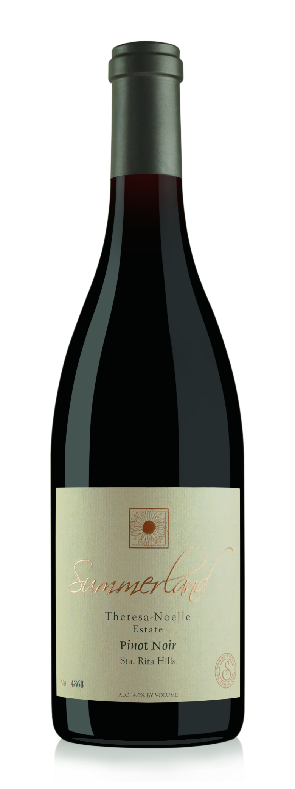
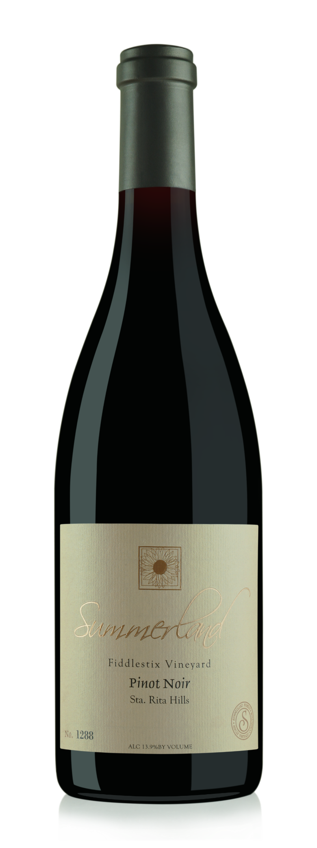
Summerland Single Vineyard Pinot Noirs
Sourced from premier vineyards in the world-renown Santa Ynez Valley, these single vineyard Pinot Noirs are created to reflect the terroir nuances from each individual location.

Slide 3
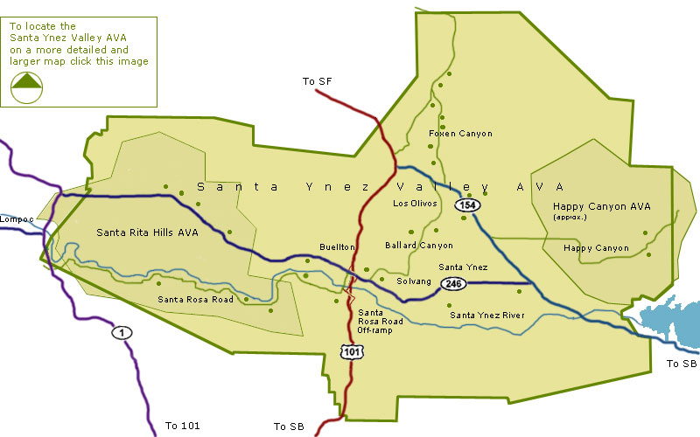
Santa Rita Hills AVA – Perfect For Pinot Noir
Part of the larger Santa Ynez Valley AVA
Located between the Purisima Hills on the North and Santa Rosa Hills to the South
Influenced by fog and cool ocean breezes from the Pacific Ocean
Rolling, hilly topography with rocky soil

Slide 4
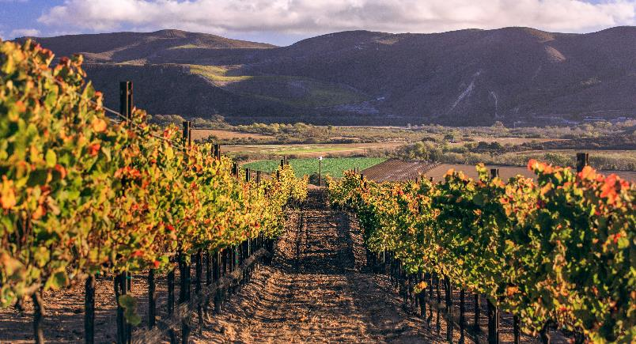
The Vineyards Of Summerland – Theresa Noelle
The Theresa Noelle vineyard is located on the western end of the Santa Rita Hills AVA in Santa Ynez Valley. The hillside location is planted to four clones of Pinot Noir, clone 828, clone 115, clone 667 and clone Pomard, with the vineyard showing distinct flavor profiles attributed to Dijon clones. In the fall, the grapes are hand-harvested and selected for the Proprietors program with the utmost quality in mind.

Slide 5
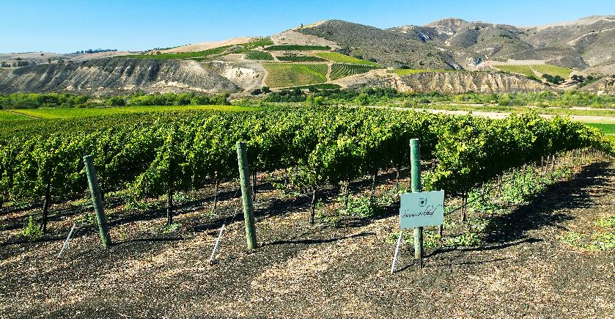
The Vineyards Of Summerland - Fiddlestix
Fiddlestix is the quintessential Pinot Noir dream vineyard, in the fog-laden, cool climate Sta. Rita Hills AVA, at mile marker 7.28 on Santa Rosa Rd. In 1996, Kathy Joseph purchased what was a 133 acre “flower farm” and helped nurture the Sta. Rita Hills AVA granted in 2001. The soil is well-drained Gazos and Botella clay loam, loaded with chirt and Monterey shale. The vineyard is designed to 32 mini-blocks, representing unique combinations of six clones and three rootstocks, at various elevations, exposures, and soil compositions. We sustainably nurture the vineyard and customize our faming in sync with vintage demands; yields are carefully controlled with harvest done at night and field sorted by hand.

Slide 6
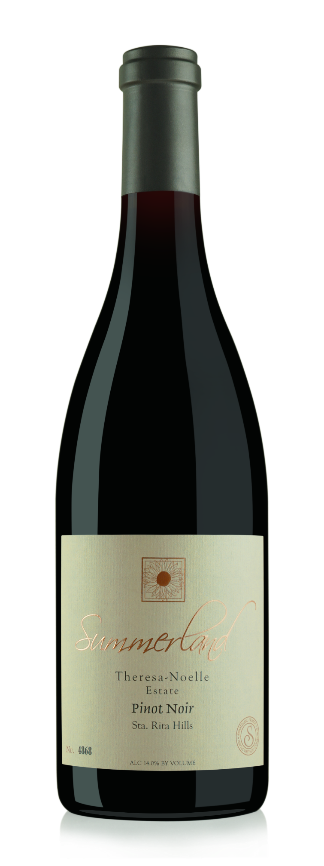
2015 Theresa Noelle Vineyard Pinot Noir
Vineyards
This vineyard is located on the western end on the Santa Rita Hills AVA. Planted to four clones of Pinot Noir, clone 828, clone 115, clone 667, and clone Pomard, the vineyard shows distinct flavor profiles attributed to Dijon clones. In the fall, the grapes are hand harvested and selected for this wine with the utmost quality in mind.
Tasting Notes
A deep ruby color paired with red fruit and floral aromatics, this wine immediately excites the senses. On the palate you will find earthy notes, along with bright cherry and cranberry leading into hints of tobacco with balanced acid, complex herb and oak profiles and a long finish.
Varietal: Pinot Noir Alc: 14.6% pH: 3.59 TA: 0.60 g/100ml Cases: 200

Slide 7
2016 Fiddlestix Vineyard Pinot Noir
Vineyards
Located in the heart of the Santa Rita Hills appellation, Fiddlestix Vineyard encompasses some of the finest cool climate Pinot Noir grown on the Central Coast. We work closely with vineyard owner Kathy Joseph to obtain optimum ripeness and flavors at harvest. Summerland Winery sources the Pommard cultivar along with the Dijon clones 667, 777, 113 from Fiddlestix Vineyard.
Tasting Notes
Our Fiddlestix Pinot Noir begins slightly sweet with rich aromas of dark berry fruits. On the palate, this wine shows warm, rich fruit flavors supported with elevated perfume notes of sweet oak, spice and vanilla. The wine’s nicely integrated French Oak adds to the sweetness and overall softness with a long, lush finish.
Varietal: Pinot Noir Alc: 15.2% pH: 3.41 TA: 0.60 g/100ml Cases: 250

Slide 8
Past Accolades
Theresa Noelle
2014 92 pts, Wine Enthusiast, February 2018
2013 Best of Class/Double Gold, 2017 Intl Women’s Wine Competition
Gold Medal, 2016 Ojai Wine Festival
Gold Medal, 2016 San Francisco International Wine Competition
2012 92 pts, Wine Enthusiast, Dec 2014
Gold Medal – 2015 Denver International Wine Competition
Gold Medal – 2015 Pinot Noir Shootout
Fiddlestix
2011 93 pts, Wine Enthusiast, July 2014
2010 94 pts, Wine Enthusiast, December 2014
Double Gold Medal, 2015 Denver International Wine Competition

Slide 9
Updated Package
Single Vineyard Collection designation for top tier of the Summerland brand
Key design elements incorporated from new Summerland Central Coast Collection label
Elegant black and gold label for a sophisticated look
Available on the 2018 Fiddlestix and 2017 Theresa Noelle wines

Slide 10
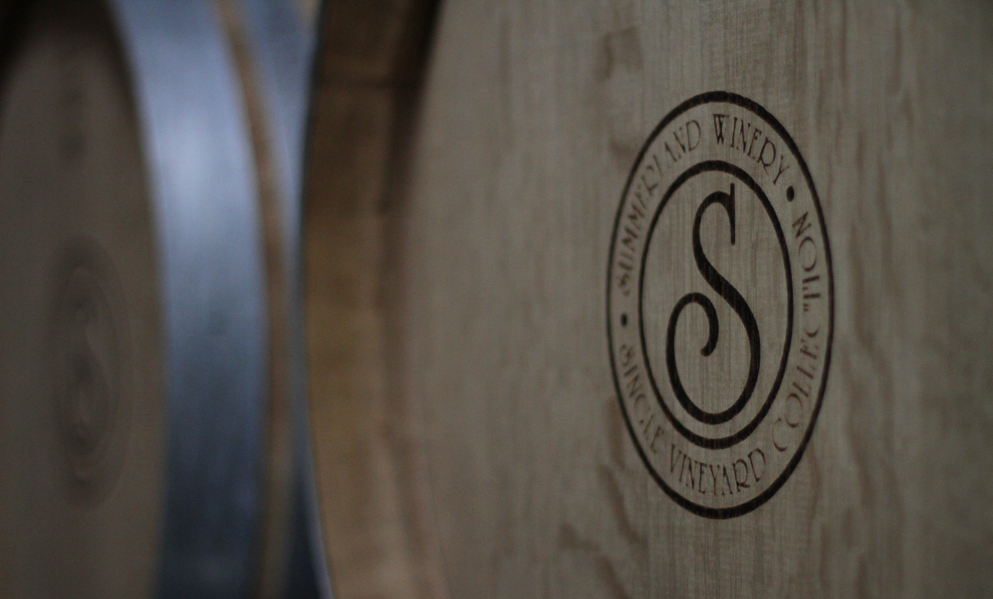
Summerland Single Vineyard Pinot Noirs
Summerland’s top-tier showcasing the best Pinot Noir vineyards in Santa Ynez Valley
Limited production allowing our winemakers to be selective during harvest and blending process
New, luxury packaging and stronger branding that builds portfolio image

